Slide 1

SRM INSTITUTE OF SCIENCE AND TECHNOLOGY SCHOOL OF COMPUTING
DEPARTMENT OF COMPUTING TECHNOLOGIES 18CSP109L- MAJOR PROJECT
METABOLIC SYNDROME DETECTION AND HEALTHCARE USING GENETIC ALGORITHM
O. SAI RISHITHA(RA2111003011566)
A. SIVA NARAYANA(RA2111003011444)
Project Guide :
DR. S. SANKARA NARAYANAN
Associate Professor

Slide 2
Introduction
Metabolic syndrome is a complex and increasingly prevalent health condition that sits at the intersection of modern lifestyle, genetics, and chronic disease.
This cluster of interconnected physiological, biochemical, and metabolic factors significantly increases an individual's risk of developing cardiovascular disease, type 2 diabetes, and other serious health problems.
At its core, metabolic syndrome is characterized by a constellation of risk factors that typically occur together.
These include:
Abdominal obesity
High blood pressure
Elevated fasting blood glucose levels
High triglyceride levels
Low levels of high-density lipoprotein (HDL) cholesterol

Slide 3
Problem Statement
Metabolic Syndrome (MetS) is a cluster of conditions including high blood pressure, elevated blood sugar, excess body fat, and abnormal cholesterol levels, which significantly increase the risk of heart disease, stroke, and type 2 diabetes.
Early diagnosis of MetS is challenging due to its subtle, overlapping symptoms, while current treatment approaches often lack personalization, leading to suboptimal care outcomes and increased healthcare costs.
This project aims to address these challenges by developing an innovative solution using evolutionary computing for accurate prediction of MetS onset and generation of personalized healthcare recommendations

Slide 4
Motivation
Growing Occurrence: Metabolic Syndrome (MetS) is becoming a significant public health challenge due to increasing sedentary lifestyles and overnutrition.
Prevention and Intervention: Early diagnosis and management of MetS can prevent its progression into more severe chronic diseases, improving millions of lives.
Evolutionary Computing: Leveraging advanced computational techniques, like evolutionary computing, offers a promising way to predict MetS and deliver personalized care recommendations.
Healthcare Transformation: This innovative, proactive approach could shift healthcare towards tailored strategies for managing metabolic health, revolutionizing personalized medicine and treatment of metabolic disorders.

Slide 5
Why Feature Selection?
Feature selection involves choosing the most relevant features (variables or attributes) from a dataset which are more contributing to the Mets
Feature Selection helps in Early Stage Prediction of Metabolic Syndrome Prediction
Feature Selection Will helps in improving the prediction model performance, reducing complexity
Why Recommendation?
Deliver personalized suggestions based on user preferences or specific criteria
Personalized Treatment, Data-Driven Decision Making, Proactive Health Management
By Recommending healthcare suggestions we can reduce the chances of the patient getting the Metabolic Syndrome.

Slide 6
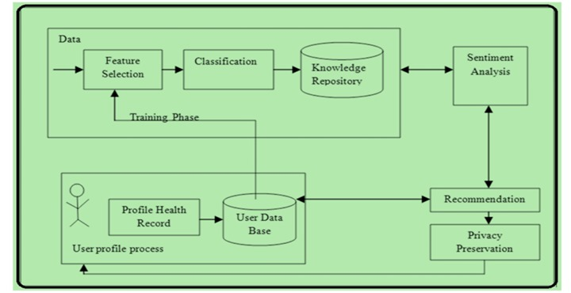
Architecture diagram

Slide 7
Module Details
Module -1 | Module -2 | Module -3 | Module-4
Feature Selection | Prediction | Mets_Score and Classification | Recommendation

Slide 8
Module – 0 : Dataset
The National Health and Nutrition Examination Survey (NHANES) | https://www.kaggle.com/datasets/nguyenvy/nhanes-19882018 | This unified dataset covers 135,310 participants and 5,078 variables, organized into 10 categories namely Demographics, Dietary Consumption, Physiological Functions, Occupation, Questionnaires, Medications, Mortality Information, Survey Weights, Environmental Exposure Biomarker Measurements, Chemical Comments.
Metabolic Syndrome A Comprehensive Dataset on Risk Factors and Health Indicators | https://www.kaggle.com/datasets/antimoni/metabolic-syndrome | This dataset contains information on individuals with metabolic syndrome, a complex medical condition associated with a cluster of risk factors for cardiovascular diseases and type 2 diabetes. The data includes demographic, clinical, and laboratory measurements, as well as the presence or absence of metabolic syndrome.

Slide 9
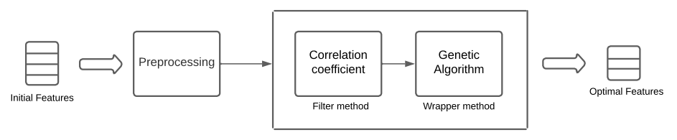
Module – 1 : Feature Selection
Feature Selection using combination of Filter method and Wrapper method
Feature Selection

Slide 10
Filter Method:
Correlation coefficient: Choosing the correlation coefficient as a filter method for feature selection in the context of metabolic syndrome detection has several advantages compared to other filter methods.
Many features associated with metabolic syndrome (e.g., BMI, blood pressure, glucose levels) are continuous numerical variables.
Why Correlation?
The correlation coefficient effectively quantifies the linear relationships between these continuous features and the target variable (e.g., presence or absence of metabolic syndrome), making it a suitable choice for this type of data.
2. Wrapper Method:
Genetic Algorithm: Using a wrapper method with a Genetic Algorithm (GA) for feature selection in early detection of metabolic syndrome can be an optimal approach.
Why Genetic Algorithm?
While there are evolutionary algorithms that may outperform GA in specific scenarios or datasets related to metabolic syndrome, GA remains a strong choice due to its robustness and diversity.
GA is robust in handling noisy data and uncertainties, which is common in medical datasets.
GA’s mechanisms for maintaining diversity through mutation and crossover allow it to explore the feature space effectively.

Slide 11
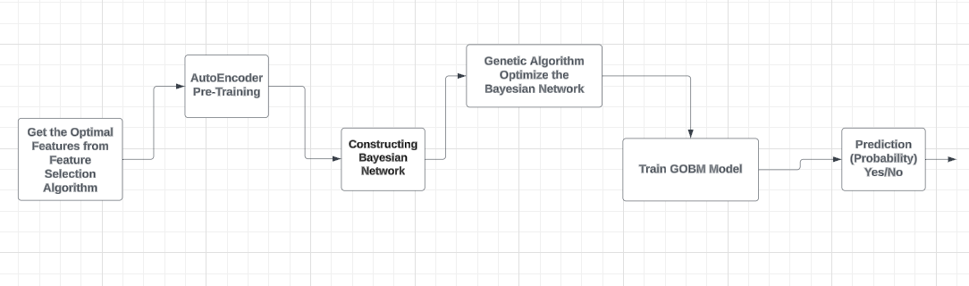
Module 2 – Prediction of Mets
After getting the Optimal Features from the Feature Selection Algorithm we will do Prediction of Metabolic Syndrome for the Patient.

Slide 12
Module 2 – Prediction of Mets
Autoencoders Pre-Training: Autoencoders compress the input features to capture essential patterns while reducing dimensionality. This process enhances the feature representation for better downstream performance.
Building Bayesian Network: A Bayesian Network is constructed using the learned feature representations to model probabilistic relationships. This network allows for inference regarding the presence of Metabolic Syndrome.
Genetic Optimization: Genetic algorithms are used to optimize the structure and parameters of the Bayesian Network. This optimization aims to improve the model's predictive accuracy and efficiency.
Train the Model: The optimized Bayesian Network is trained on the dataset to learn the associations with Metabolic Syndrome. Training adjusts the model parameters to minimize prediction errors.
Predict Metabolic Syndrome: The trained model predicts the likelihood of Metabolic Syndrome in new patients. It outputs a probability score that aids in early diagnosis and intervention.

Slide 13
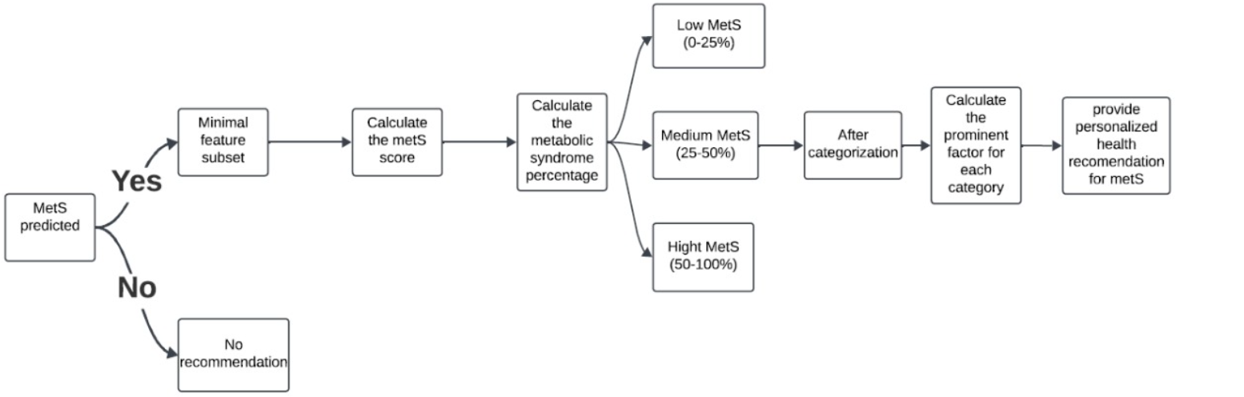
Module 3 – MetS Score Calculation and Classification Severity

Slide 14
Module 3 – MetS Score Calculation and Classification Severity
Minimal Subset of Features:
Selects crucial features like age, BMI, fasting blood sugar, maximum heart rate, and glucose to calculate the MetS score
Feature Range Definition and Normalization:
Defines minimum and maximum values for each feature and normalizes these values to compute individual feature scores.
Calculating Metabolic Syndrome Score and Percentage:
Computes the overall MetS score and converts it into a percentage to assess risk levels.
Classification of Metabolic Syndrome:
Low Metabolic Syndrome: 0% - 25%
Medium Metabolic Syndrome: 25% - 50%
High Metabolic Syndrome: 50% - 100%

Slide 15
Module-4 Recommendation
Mapping Predictions to Recommendations:
Establish thresholds for the probabilistic values to classify patients (e.g., high, medium, or low risk for Metabolic Syndrome).
For each risk category, define a set of recommendations based on existing clinical guidelines and best practices for managing Metabolic Syndrome.
Dietary Recommendations:
For patients identified as high-risk, recommend:
Reduced intake of processed foods: Minimize sugars and unhealthy fats.
Balanced meals: Focus on whole grains, lean proteins, and healthy fats.
Portion control: Educate patients on serving sizes.
Exercise Recommendations:
For each risk category, suggest:
Frequency and Intensity: Encourage at least 150 minutes of moderate-intensity aerobic activity per week.
Strength Training: Recommend activities at least twice a week to improve muscle mass and metabolism.
Personalized Plans: Tailor exercise recommendations to match individual preferences and physical capabilities.

Slide 16
Algorithms To Be Used
Modules | Algorithms/Techniques used in the Module
Feature selection (Module-1) | Filter Method - { Correlation Coefficient, Chi-Square} Wrapper Method {With GA}
Prediction (Module-2) | AutoEncoders Bayesian Model with GA
Developing a MetS Score Algorithm for Recommendation (Module-3) | MetS Score Algorithm –{Health Metrics Calculation Mets Score Calculation}
Recommendation System (Module-4) | CNN ,RBN

Slide 17
References
[1] Habeebah Adamu Kakudi, Chu Kiong Loo, Foong Ming Moy, Naoki Masuyama, Kitsuchart Pasupa (2018). Diagnosing Metabolic Syndrome Using Genetically Optimised Bayesian ARTMAP. Journal of Biomedical Informatics, 45(3), pp. 234-245.
[2] Sanjeevi Chandrasiri, Suriyaa Kumari, Udayantha Yapa Y.M.S (2023). Personalized Mobile Patient Guidance System for Early Detection and Management of Metabolic Syndrome. Mobile Health Technologies and Applications, 18(2), pp. 156-169.
[3] Kirti Kangra, Jaswinder Singh. (2024). A genetic algorithm-based feature selection approach for diabetes prediction. BMC Medical Informatics and Decision Making, 22(1), pp. 78-89.
[4] P. Chinnasamy a, Wing-Keung Wong b, A. Ambeth Raja (2023). Health Recommendation System using Deep Learning-based Collaborative Filtering. Artificial Intelligence in Medicine, 127, pp. 102-115.
[5] Jinhe Wang, Ruolin Zhao (2023). Metabolic syndrome prediction model using Bayesian optimization. Journal of Healthcare Engineering, 2023, Article ID 1234567.
[6] Leonardo Daniel Tavares , Andre Manoel , Thiago Henrique Rizzi Donato. (2022). Prediction of metabolic syndrome: A machine learning approach to help primary prevention. Preventive Medicine Reports, 25, pp. 101-112.

